Slide 1
Stasis Theory
Technical Communication Landing Site
Alan Browning, Ruikang Ding, Rico Romeo,
Mike Winiarczyk, Jacob Wright
Notes:
Pitt Tech Comm 1 page Website (using html/css).
Landing Page
Calendar of events in column
Why Tech Comm?
Tech Comm Courses at Pitt
Tech Comm Resources
Components:
Create a presentation in Google Slides using stasis theory.
Open a Github/Trello page
Start document history
Collaborate on site/manual
Deliverables: Working website/project manual

Slide 2
Overview
Introduction to Stasis Theory
Conjecture
Definition
Quality
Policy
Summary

Slide 3
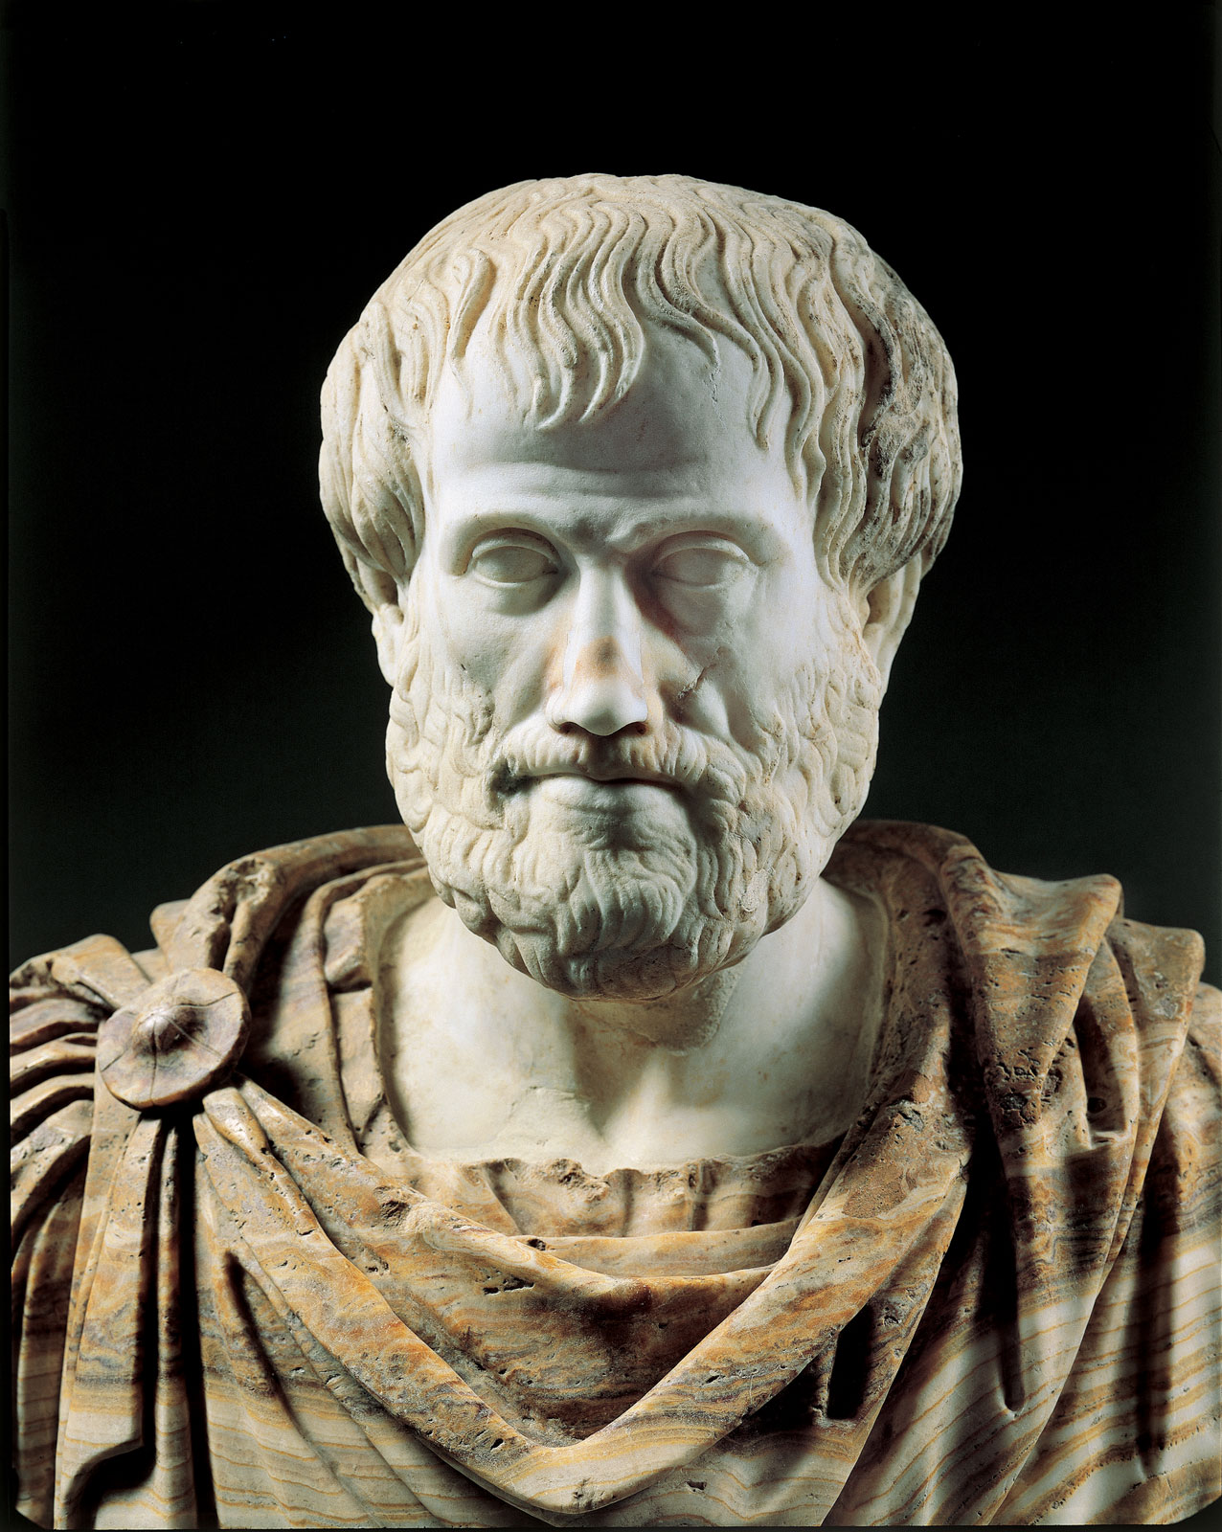

Stasis Theory
Stasis theory is a four-question, pre-writing process.
Conjecture: Determine the facts or problems.
Definition: Find out the meaning of the facts or nature of the issues.
Quality: Think about the influence of the facts or problems.
Policy: Raise ideas to deal with the facts or problems.
Notes:
Stasis theory is a four-question, pre-writing (invention) process developed in ancient Greece by Aristotle and Hermagoras. Later, the stases were refined by Roman rhetoricians, such as Cicero, Quintilian, and Hermogenes. Working through the four stasis questions encourages knowledge building that is important for research, writing, and for working in teams. Stasis theory helps writers conduct critical analyses of the issues they are investigating.
Specifically, stasis theory asks writers to investigate and try to determine:
The facts (conjecture)
The meaning or nature of the issue (definition)
The seriousness of the issue (quality)
The plan of action (policy).
The four basic stasis categories may be broken down into a number of questions and subcategories to help researchers, writers, and people working together in teams to build information and compose communication. The stases also help people to agree on conclusions, and they help identify where people do not agree. Here are the stases and some questions you can ask to help you conduct research, write, and work toward solving problems:

Slide 4

Conjecture - What are the Facts?
Technical communication is a small field at Pitt
Few classes
No official website
Not an autonomous department
Classes are not easily discoverable
Many students miss out on important communication skills/knowledge
Notes:
Fact
Did something happen?
What are the facts?
Is there a problem/issue?
How did it begin and what are its causes?
What changed to create the problem/issue?
Can it be changed?
It may also be useful to ask critical questions of your own research and conclusions:
Where did we obtain our data and are these sources reliable?
How do we know they're reliable?

Slide 5


Definition - The Issues with Pitt Tech Comm
Subjective Issue: The university does not attach great importance to technical communication. Courses of technical communication seem dispensable.
Advertisement for technical communication courses is insufficient.
It does not matter for future career if students do not systematically learn technical communication.
Objective Issue: The university lacks professional education system including resources and faculty to teach technical communication courses to students.
The teaching resources like tutorials and online systems are scarce.
Faculties who are professional in technical communication are in demand.
Notes:
Definition (Ruikang)
What is the nature of the problem/issue?
What exactly is the problem/issue?
What kind of a problem/issue is it?
To what larger class of things or events does it belong?
What are its parts, and how are they related?
It may also be useful to ask critical questions of your own research and conclusions:
Who/what is influencing our definition of this problem/issue?
How/why are these sources/beliefs influencing our definition?

Slide 6

Quality - Impact on Pitt’s Students
Not having a clear path of tech comm courses questions the validity of Pitt’s writing program
The lack of accessible information could turn interested parties away
Students
Donors
Academics
Opportunities will be missed
The lack of clear tech comm offerings at Pitt is of
concern if the department wants to continue growing
Notes:
Quality (Mike)
Is it a good thing or a bad thing?
How serious is the problem/issue?
Whom might it affect (stakeholders)?
What happens if we don't do anything?
What are the costs of solving the problem/issue?
It may also be useful to ask critical questions of your own research and conclusions:
Who/what is influencing our determination of the seriousness of this problem/issue?
How/why are these sources/beliefs influencing our determination?

Slide 7

Policy - A Clear, Concise, and Accessible Website
Answers fundamental questions
What makes Tech Comm important, and why sign up?
Which courses are available, who teaches them?
How will I be supported by the department?
A calendar to lay out departmental events
Project manual to guide future developers
The website will be forked from another repository on Github
Notes:
Policy
Should action be taken?
Who should be involved in helping to solve the problem/address the issue?
What should be done about this problem?
What needs to happen to solve this problem/address this issue?
It may also be useful to ask critical questions of your own research and conclusions:
Who/what is influencing our determination of what to do about this problem/issue?
How/why are these sources/beliefs influencing our determination?

Slide 8
Summary
Introduction to Stasis Theory
Conjecture
Definition
Quality
Policy

Slide 9

Questions?

